Slide 1
Pivotal Tracker summary and screenshots Iteration 1
Jackson Davis, Sanya Sinha, David Woolston

Slide 2
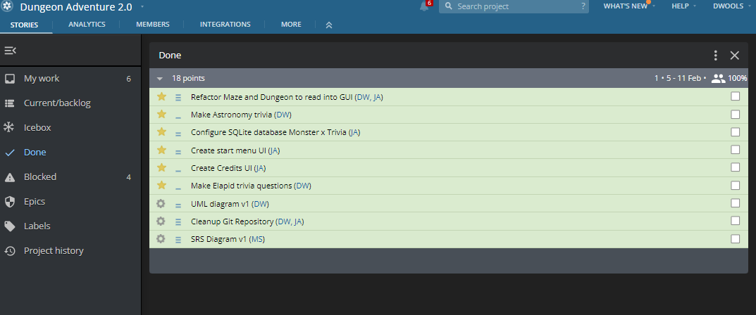
Completed User Stories

Slide 3
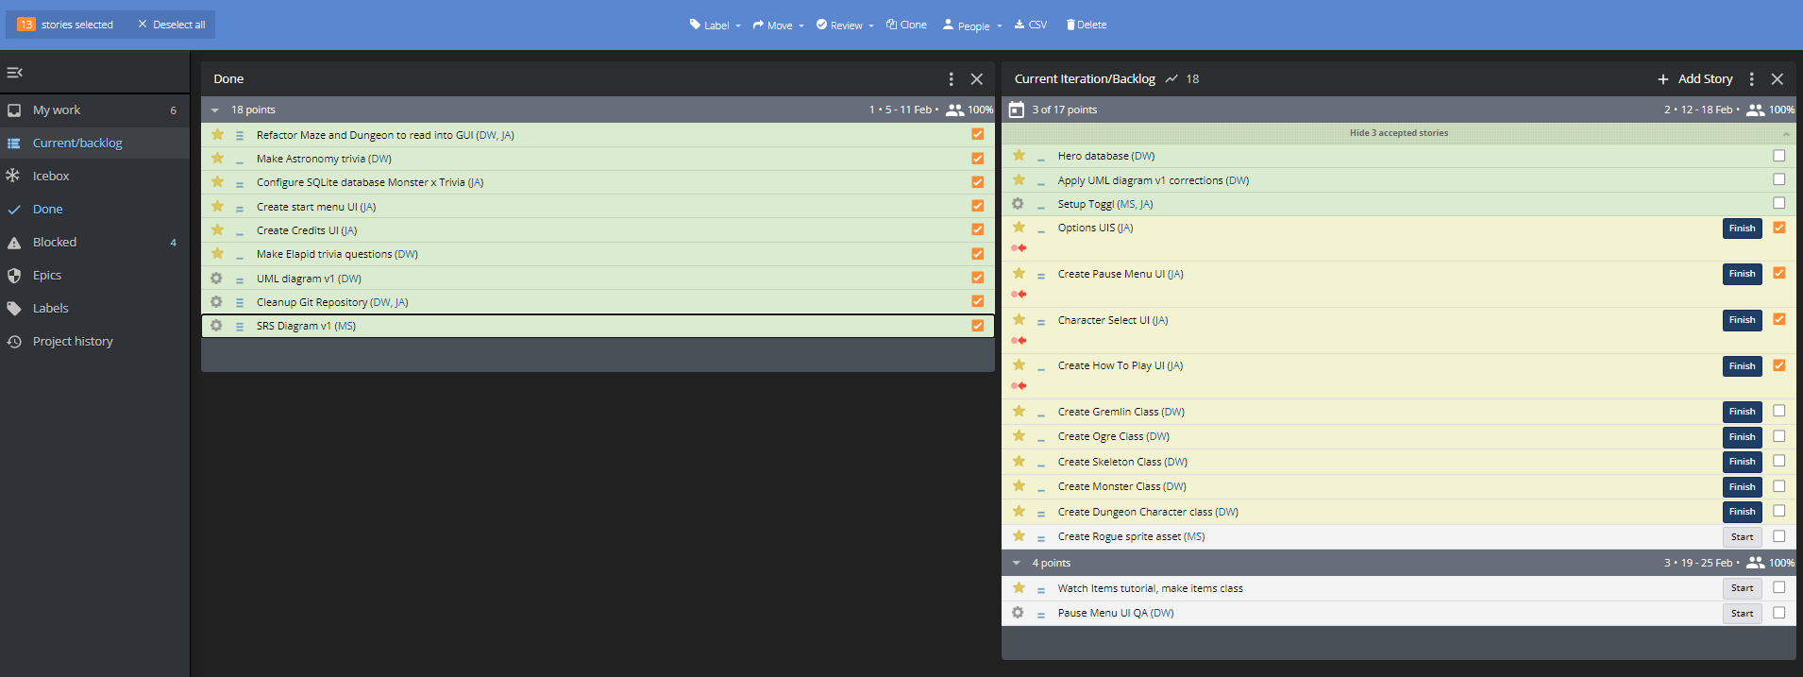
User stories created in Iteration 1 (orange checkmarks)

Slide 4
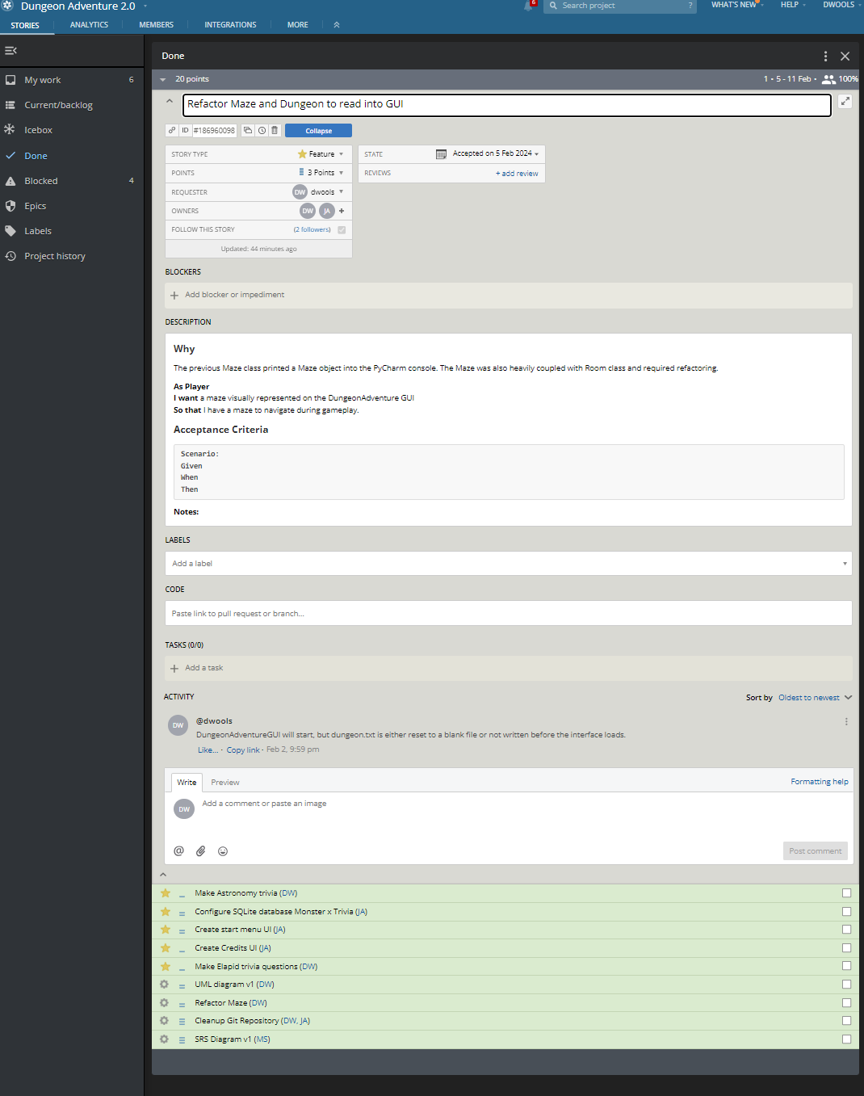
Completed User Stories

Slide 5
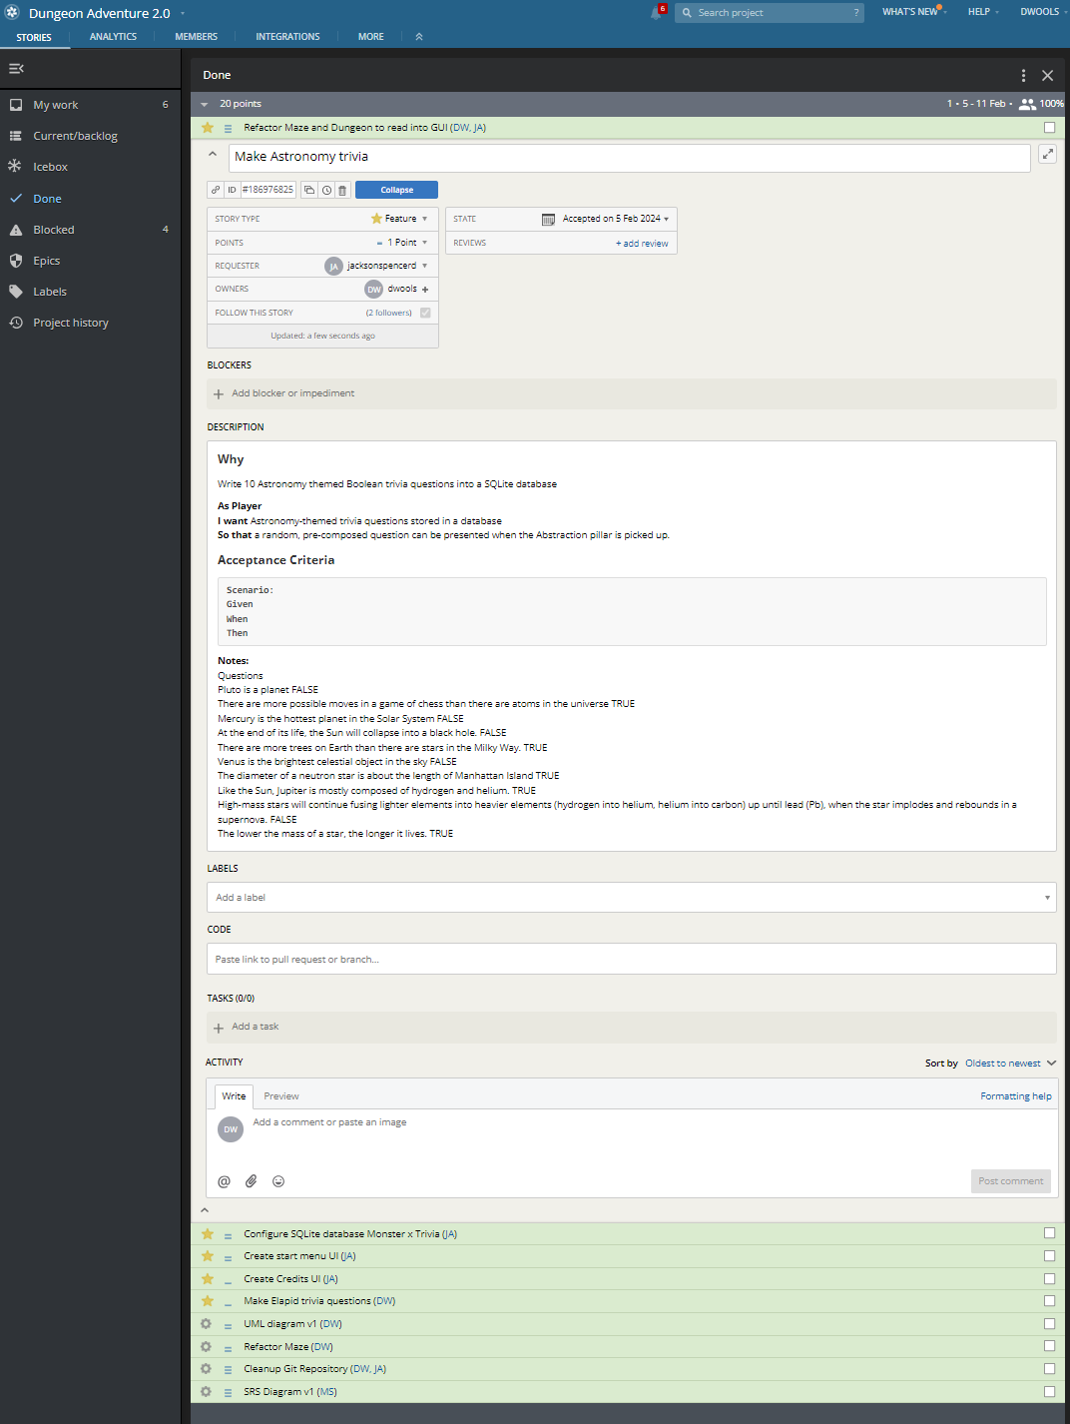
Completed User Stories

Slide 6
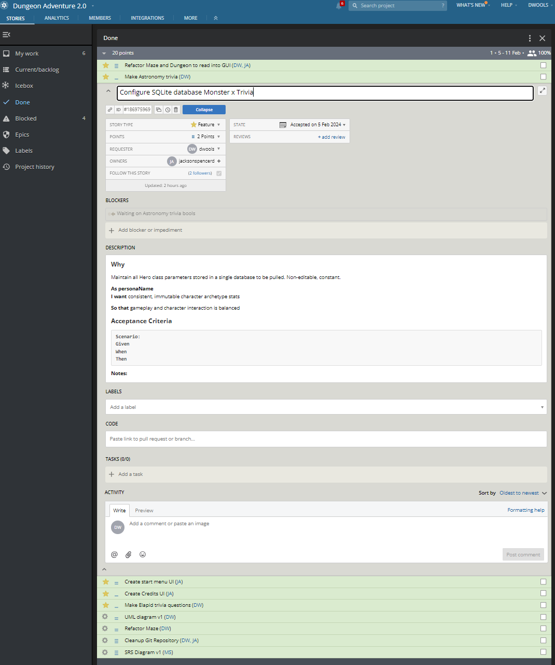
Completed User Stories

Slide 7
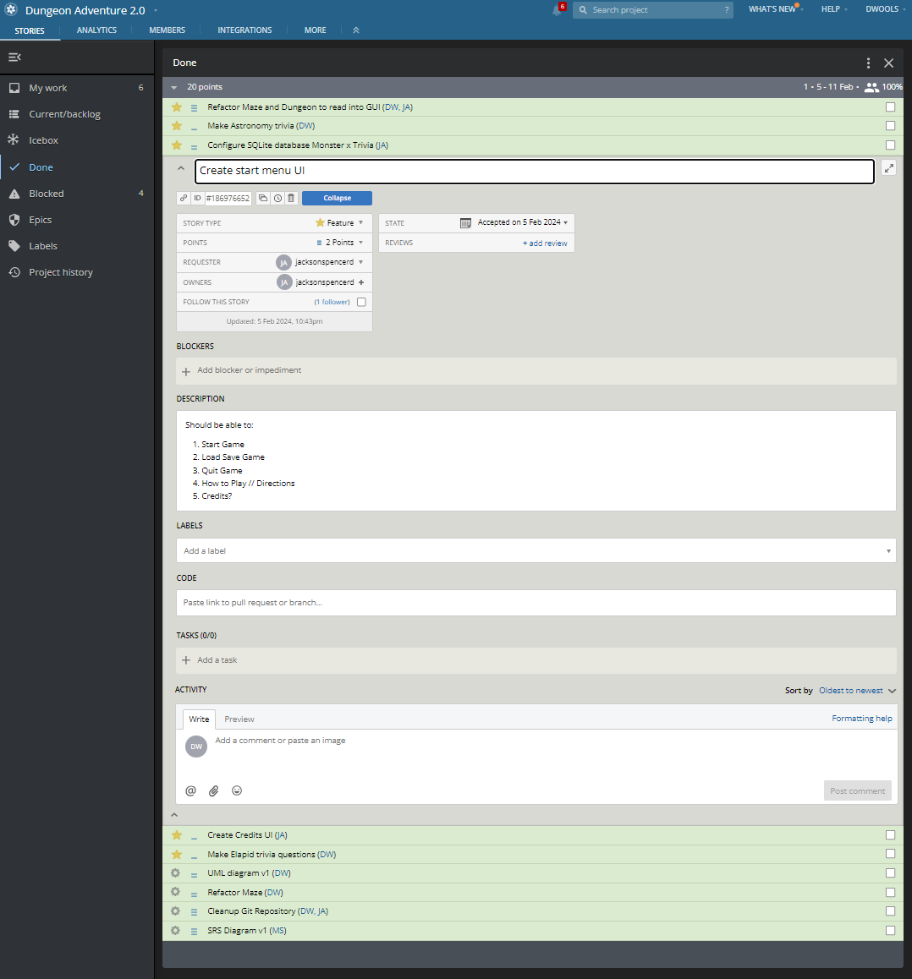
Completed User Stories

Slide 8
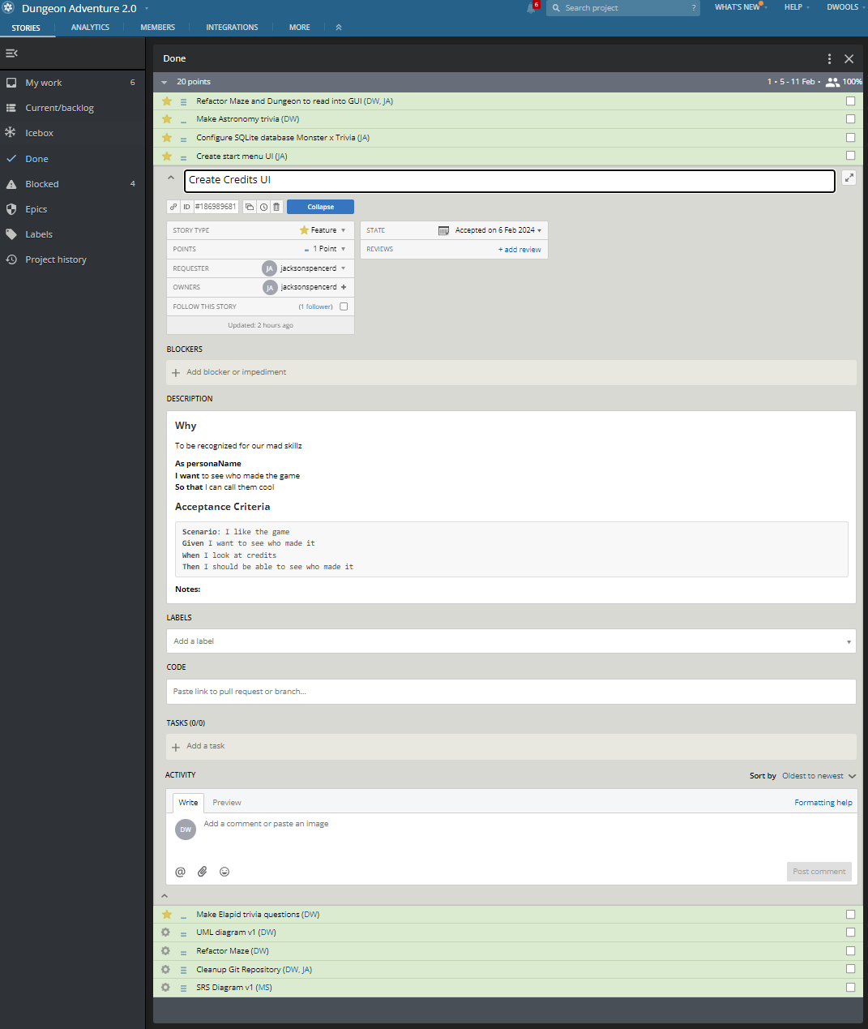
Completed User Stories

Slide 9
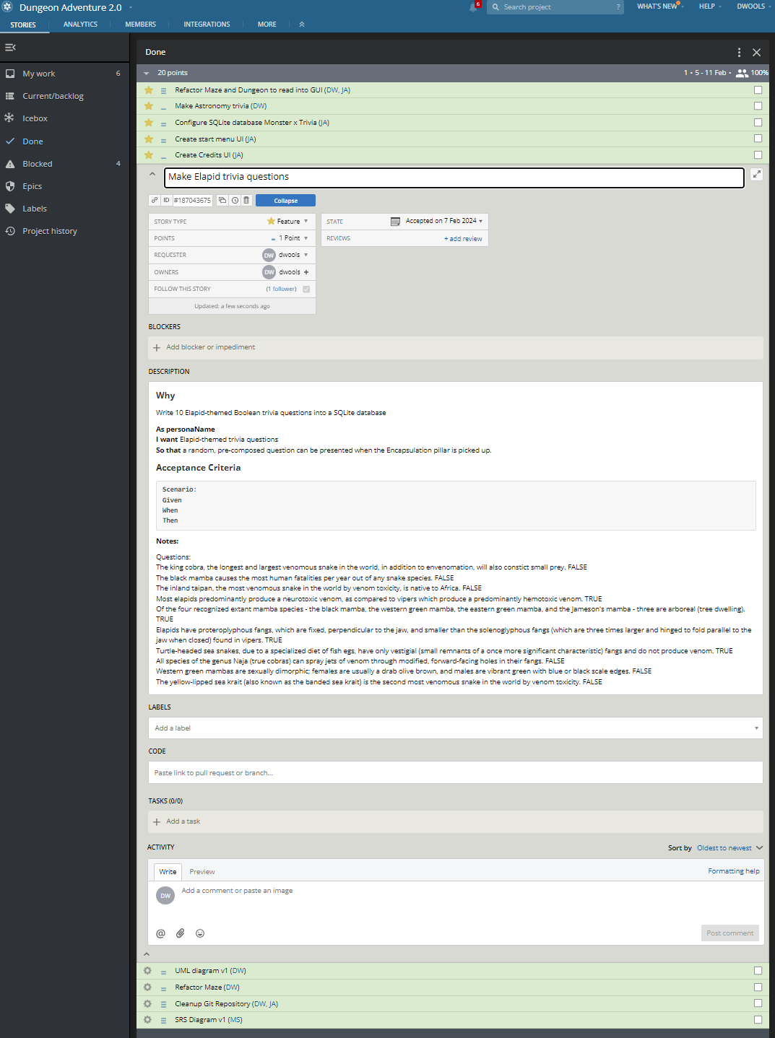
Completed User Stories

Slide 10
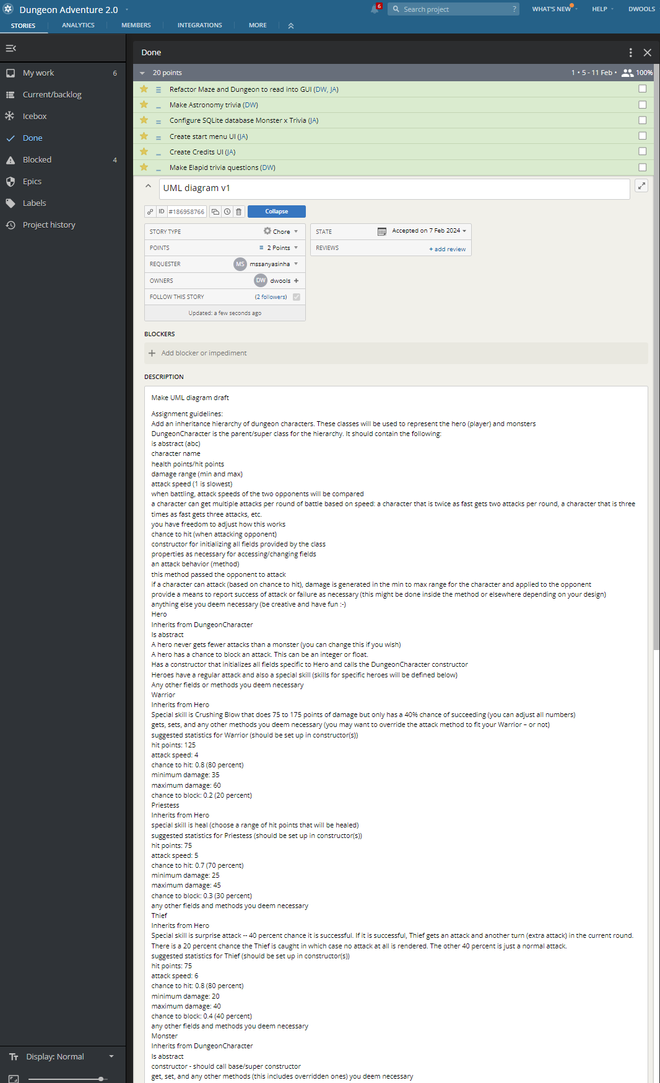
Completed User Stories

Slide 11
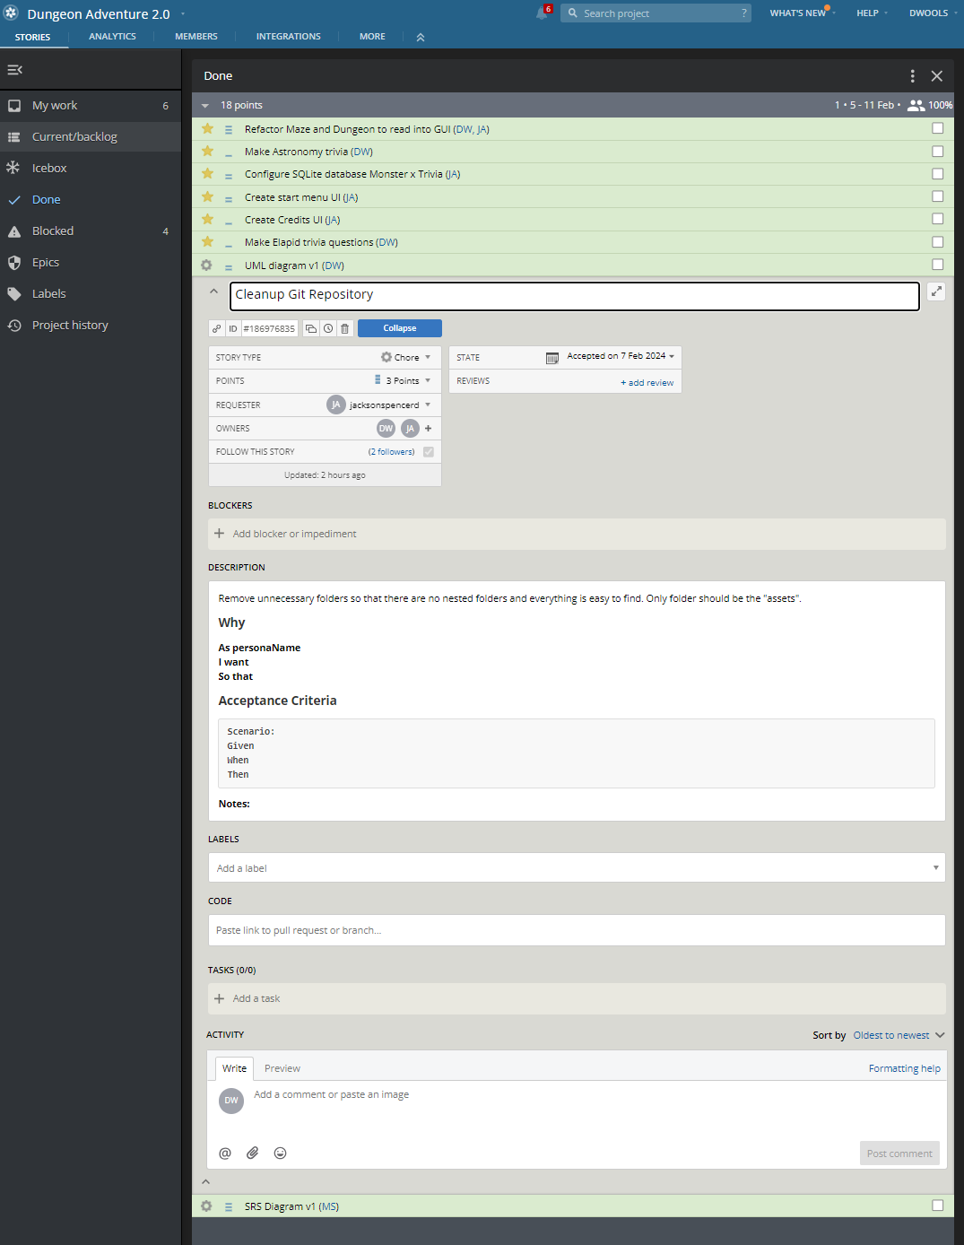
Completed User Stories

Slide 12
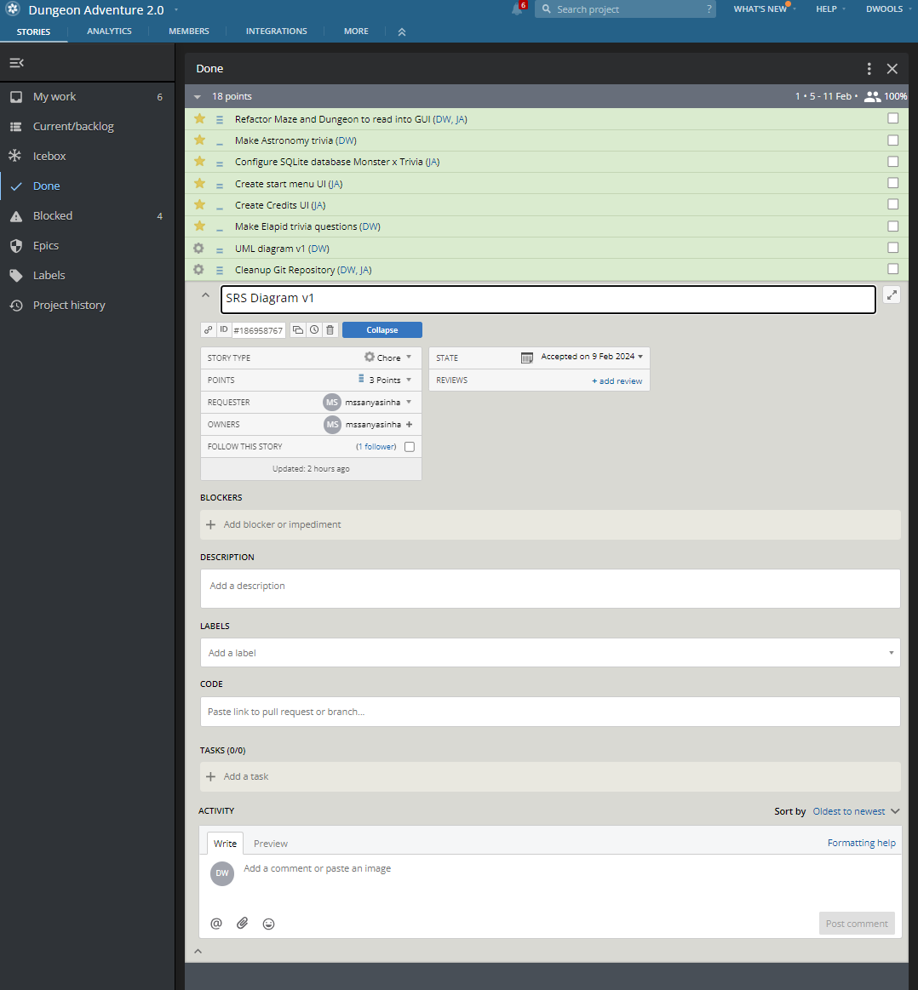
Completed User Stories

Slide 13
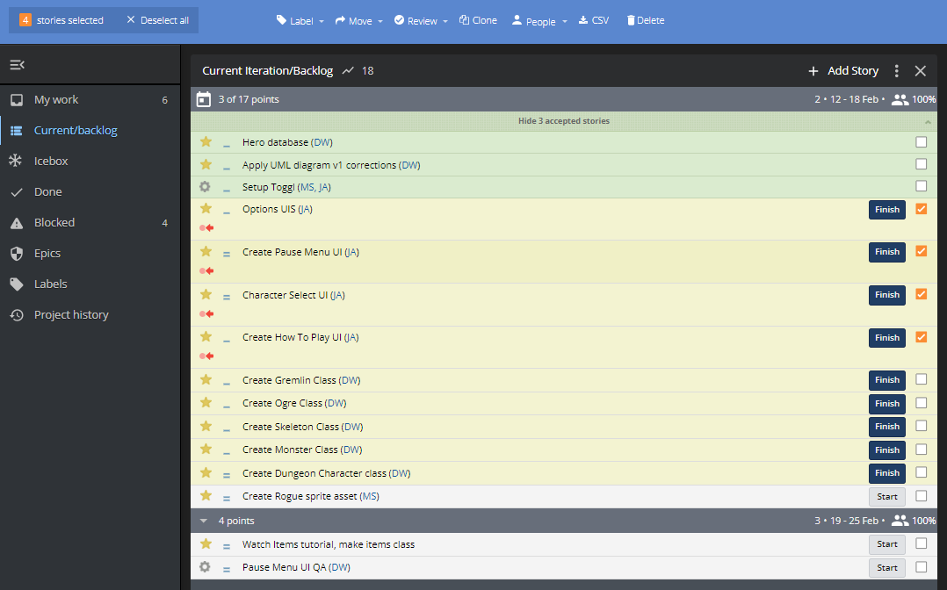
User stories created and still pending (orange checkmarks)

Slide 14
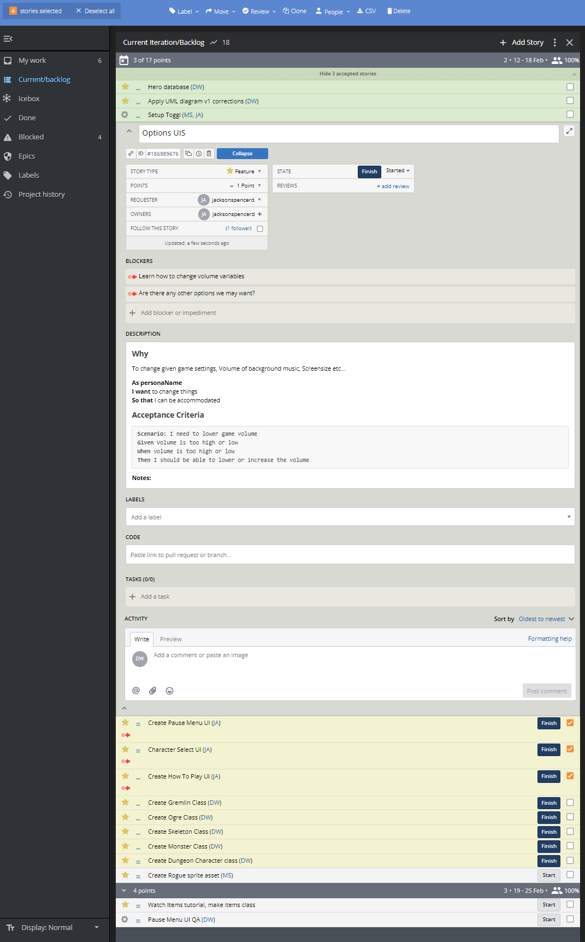
User stories created and still pending

Slide 15
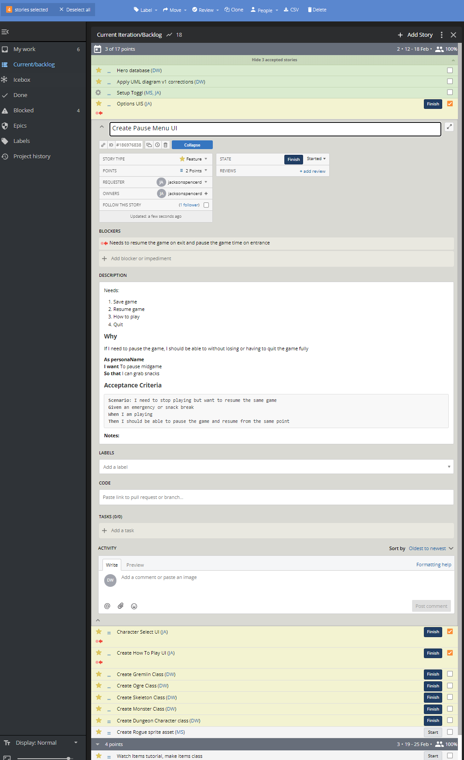
User stories created and still pending

Slide 16
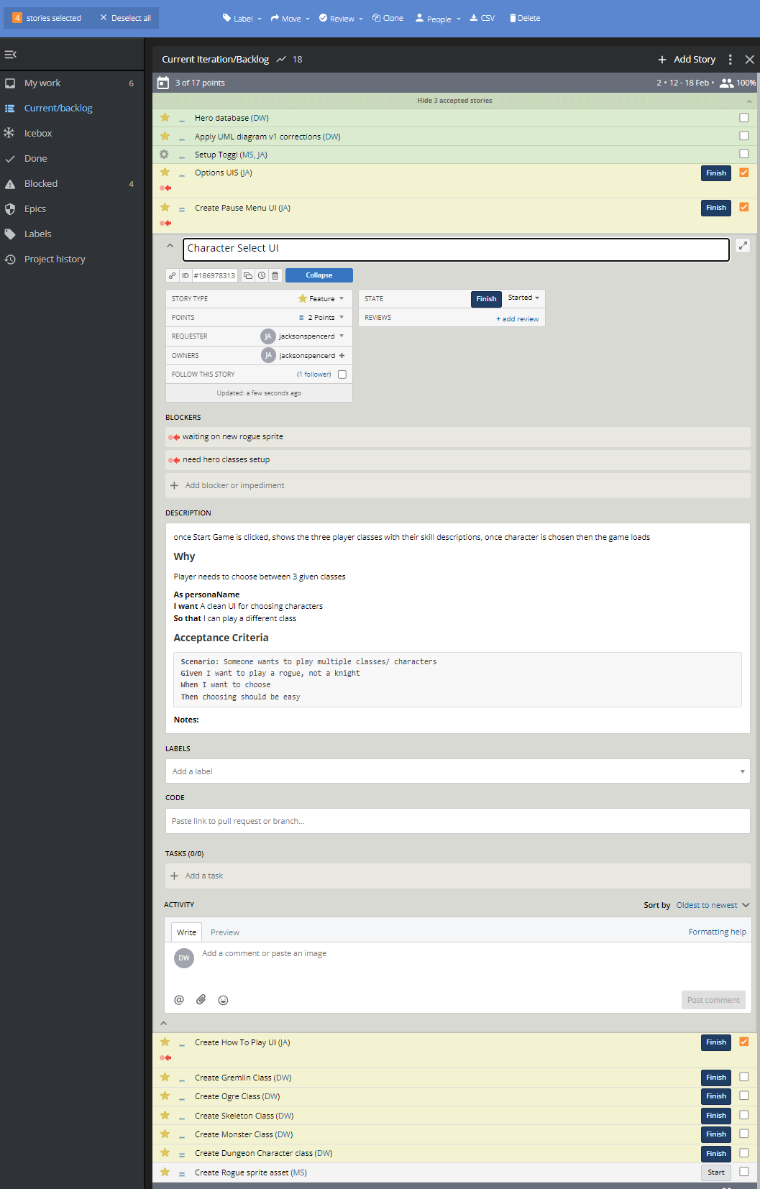
User stories created and still pending

Slide 17
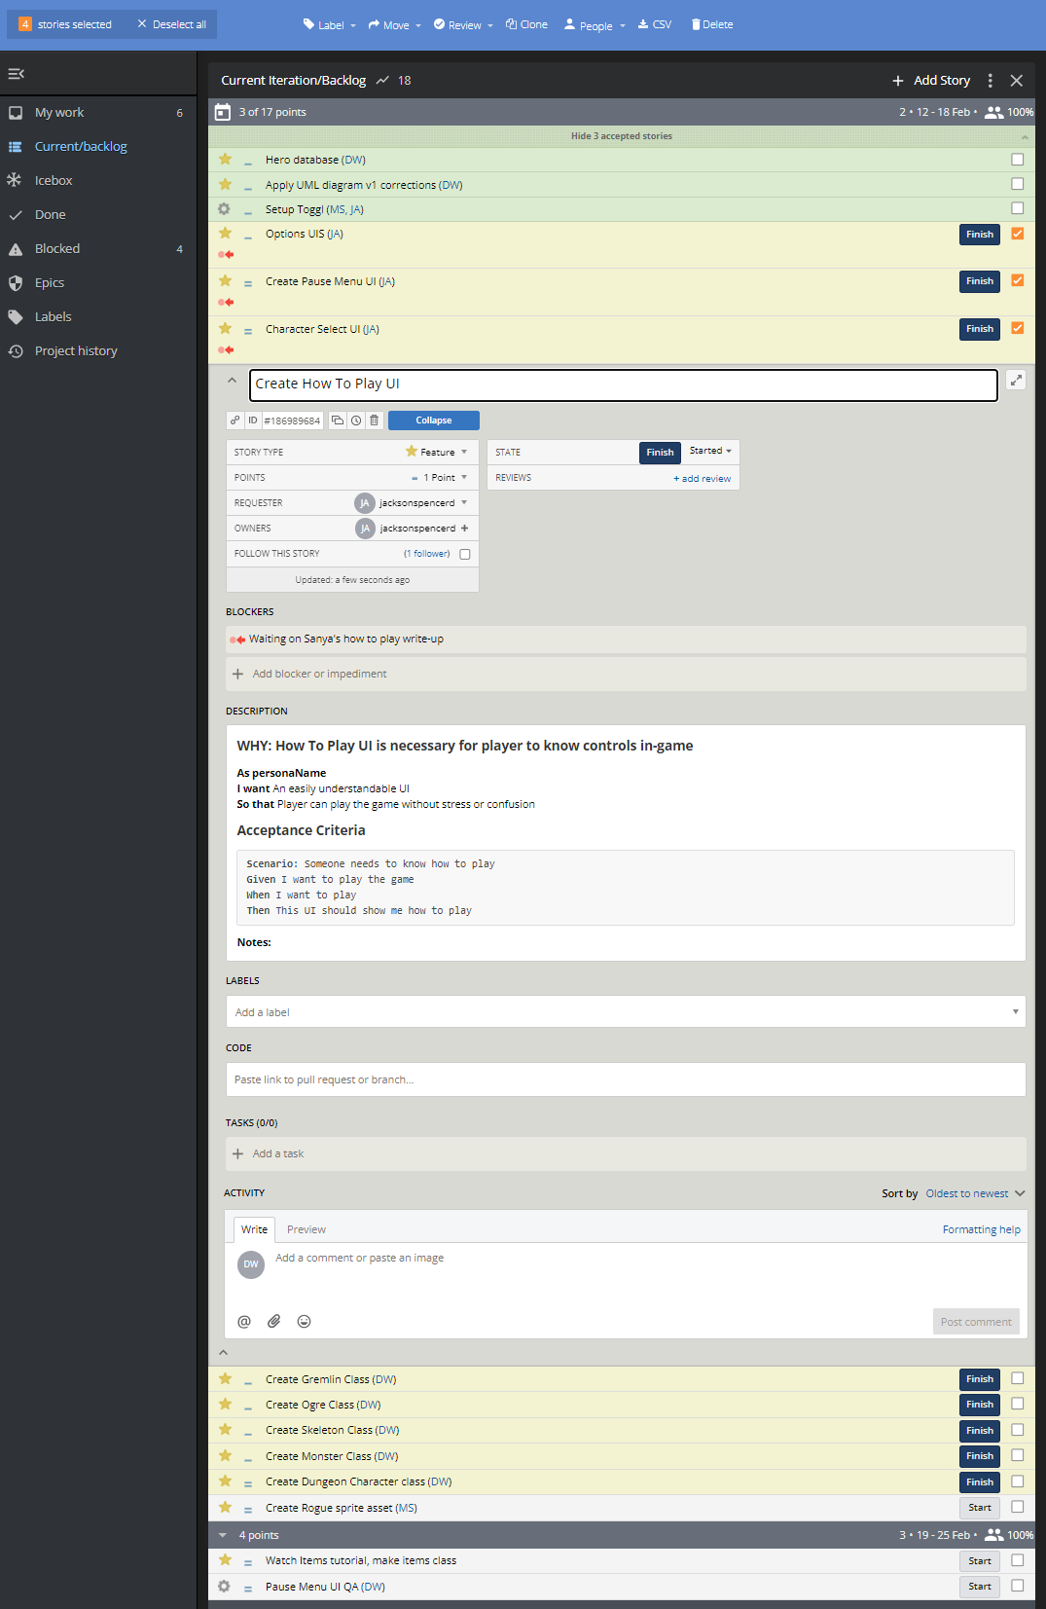
User stories created and still pending

